Slide 1
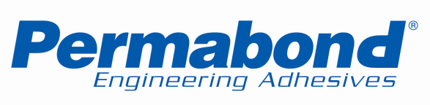
“Our Science … Your Success”

Slide 2
Permabond Product Lines
AA
Anaerobics
CA
Cyanoacrylates
ET
Two Component Epoxies
ES
One Component Epoxies
TA
Structural Acrylics
MT
Modified Epoxies
MS
MS Polymers
PT
Two Component Polyurethanes
UV
UV Curable

Slide 3
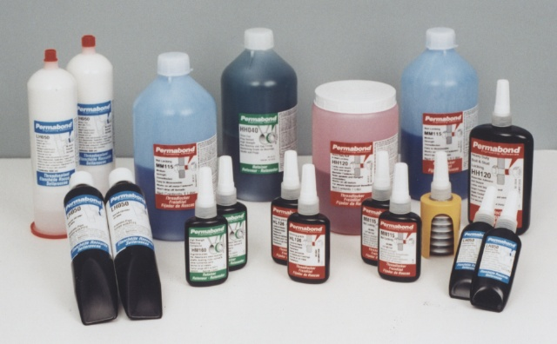
Anaerobic Adhesives & Sealants
Description
Single part liquid that cure to a solid plastic at room temperature
Used to secure tight-fitting metal parts
Cures in the presence of metal and absence of oxygen

Slide 4
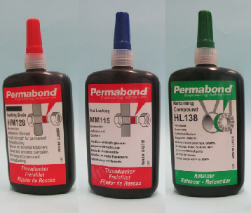
Anaerobic Adhesives & Sealants
Advantages
Less weight than mechanical locking devices
Easy clean up
Fast
No odor
Chemical and heat resistance

Slide 5
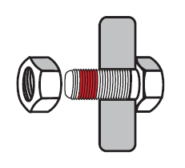
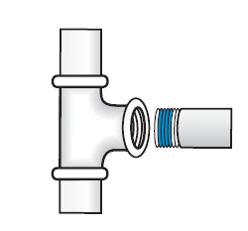
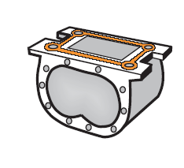
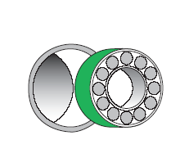
Anaerobic Adhesives & Sealants
Uses
Threadlocking
Pipe Sealing
Retaining
Gasketing
Products vary in strength, recommended substrates, viscosity, gap fill, temperature resistance and color.
Notes:
Discuss threadlocking blind hole, Retaining = press fit 750 to 2000 psi = retaining compound on machine finish up to 3400 pipesealing Sealants prevent leakage of gases and liquids from threaded pipe joints and fittings. Lock pipes in place Seals to the burst strength of most pipes Prevents corrosion and galling threads Will not contaminate the internal system
Replace Non-curing pipe dopes- Poor solvent resistance No locking effect Solvent-based pipe dopes - Shrink during cure - Fittings must be re-torqued Tapes -Teflon tape lubricates in the off direction-Potential for leaks-Contaminate fluid systemsReduces compression set and fastener loosening
Gasketing Adds structural strength to the assembly Seals all surface imperfections Allows relaxed machine tolerances Eliminates gasket inventories & bolt re-torqueing Single component no mixing - Easy to automate Easier disassembly & clean up than compression gaskets One package can be used for multiple flange sizes Flexible grades available for easy removal

Slide 6
Anaerobic Adhesives & Sealants
Product Numbering System
Permabond anaerobic numbering consists of two letters followed by three numbers. The letters indicate strength and viscosity, the numbers are unique for each product.
H = High
M = Medium
L = Low
The first letter represents strength, the second represents viscosity.
Example: LH050 = Low strength + High viscosity

Slide 7
Cyanoacrylates
Description
Single-part adhesives that rapidly polymerize at room temperature
Cure is initiated by moisture on the parts surface. Accelerators available for dry or acidic surfaces
Develop strength extremely fast

Slide 8
Cyanoacrylates
Uses
Primary bonding agent.
The adhesive is the only means of holding parts together.
Bonding dissimilar substrates.
Manufacturing aid
Fixturing parts until the next step in the process.
Fingerprint lifter
Fingerprint fuming preserves prints

Slide 9
Cyanoacrylates
Factors Affecting Performance
Humidity
Low humidity = slower cure speed
Viscosity/Gaps
Low viscosity for small gaps
Substrates
PTFE (Teflon®), Silicone, Polyethylene, Polypropylene are difficult to bond and require a primer.
Excess adhesive
Less is best
*Teflon is a registered trademarks of E.I. du Pont de Nemours and Company

Slide 10
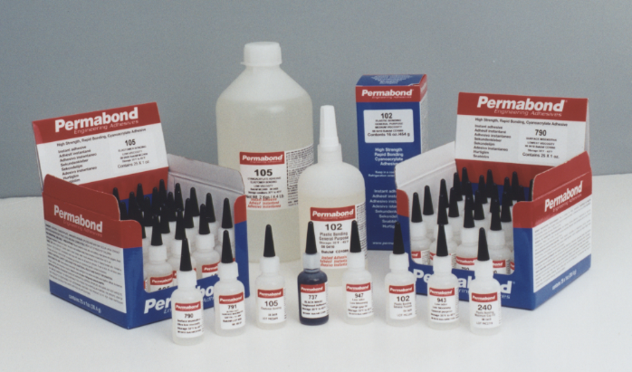
Cyanoacrylates
Specialty Grades
Elastomer Bonding
Surface Insensitive
Toughened
High Temperature Resistant
Medical Grades
Metal Bonding
Low Odor
3D Print Infiltrants
Primer and Activators

Slide 11
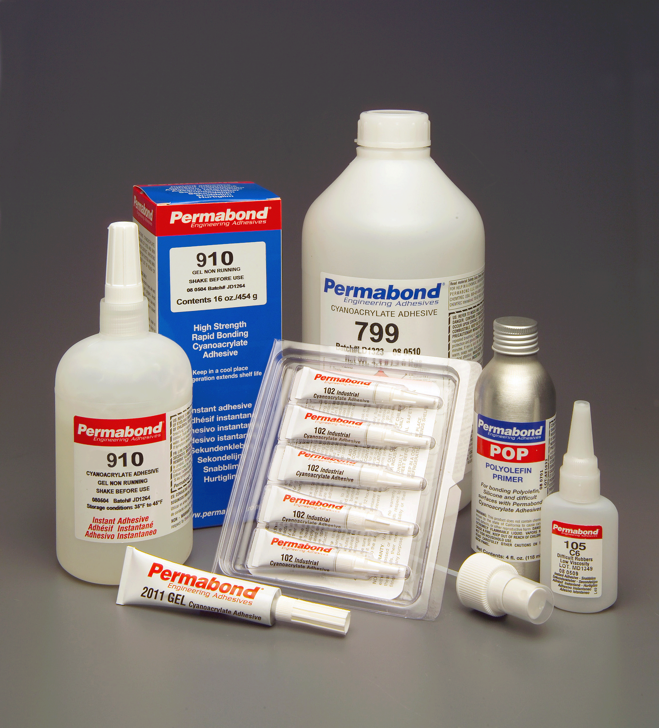
Cyanoacrylates
100 series General purpose plastic bonding, Elastomer EPDM bonding use 105 (except 170)
200 series General purpose plastic bonding
730 series Toughened, improved impact and peel resistance
790 series Surface insensitive for acidic surfaces. Extremely fast curing reduces frosting
800 series High temperature resistance (130°C to 200°C)
910 series & 170 Metal bonding
920 series High temperature resistance (250°C after post cure)
940 series Low odor, Low bloom, Reduces frosting
2000 series Thixotropic gels, Non-sag, Maximum gap filling
Notes:
Note shear values in the brochure are lap shears of grit blasted steel

Slide 12
Structural Adhesives
Description
Structural Adhesives are defined as adhesives which can support a structural load when fully cured.
They also provide:
impact and vibration resistance
high upper temperature limits
durable bonds in harsh environments

Slide 13
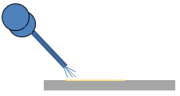
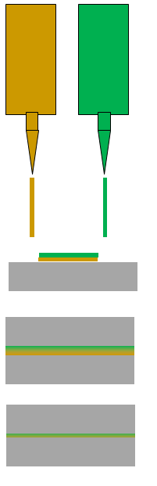
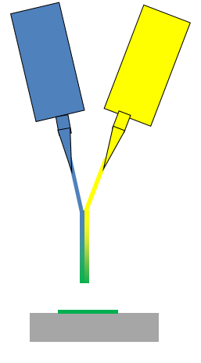
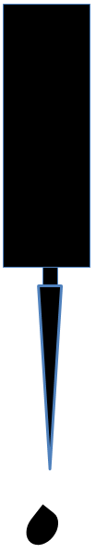
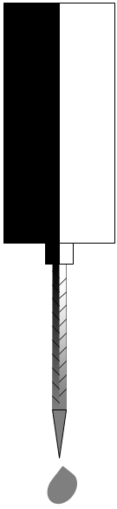
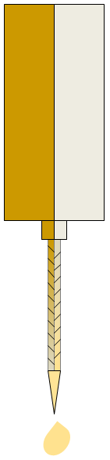

Permabond Structural Adhesives
Epoxy 1-Part
Cure with heat in an oven or by infra-red heat
Epoxy 2-Part
Cure by mixing resin and hardener in correct ratio
MMA 2-Part
Cure by mixing resin and hardener in correct ratio
Acrylic Surface Activated
Initiator to one surface - Resin to the other surface.
Acrylic Bead on Bead
1 Part is dispensed on top of the other part.
Acrylic External Mix
The two parts fall into each other during dispensing.

Slide 14
Epoxies
Description
Permabond epoxies provide structural bonds in a wide variety of applications. One and Two component epoxies are available.

Slide 15
Epoxies
Advantages
Single Part Epoxies – ES
Simple to Use
One Part - No Mixing Required
Very High Performance
Excellent Temperature Resistance
Excellent Chemical Resistance
No Pot Life Limitation
Two Part Epoxies - ET
Extremely Versatile
Cure Speed
Gap Fill
Temperature & Chemical Resistance
Bond a Wide Variety of Surfaces
Good Impact Resistance
Products available which are
manufactured in compliance with
FDA 175.105 for food
contact applications

Slide 16
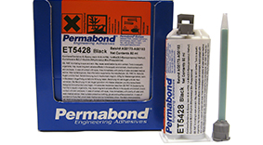
Fast Curing Adhesive For Bonding
Carbon Fiber to Aluminum
ET5428 and ET5429
ET5428
Toughened 2-part epoxy
Rapid strength development
Cream colored for GRP/FRP bonding
Available in black for bonding Carbon Fiber
20 – 30 minute handling time
Thixotropic with 0.2” (5mm) gap fill
Lap shear 2900 psi on steel and 3,800 psi FRP Glass/Epoxy
Peel strength >155N/25mm
ET5429
Toughened 2-part epoxy
Black for bonding Carbon Fiber
5 – 6 hours handling time
Thixotropic with 0.2” (5mm) gap fill
Lap shear >2,900 psi on steel and Carbon Fiber Composite
Peel strength >160N/25mm
Excellent temperature performance (435 psi shear strength at 248°F (120°C)

Slide 17
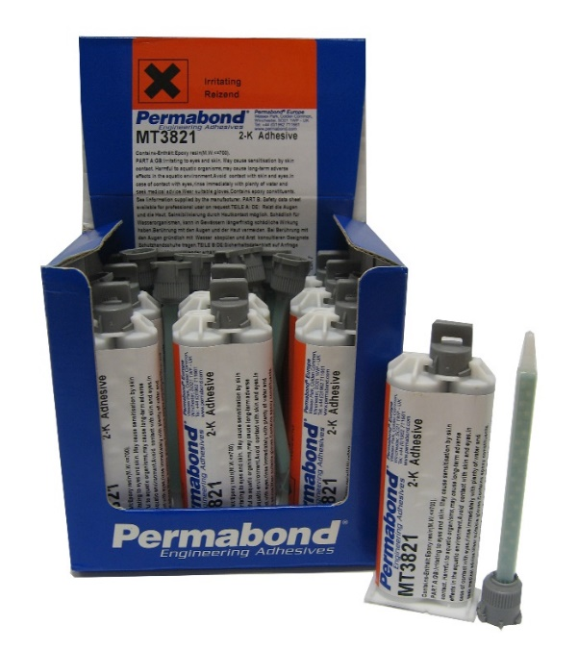
Fast Curing Adhesive For Bonding
Carbon Fiber to Aluminum
MT382 and MT3821
MT382
Hybrid 2 part modified epoxy
Highly flexible, Shore A 50
Black for bonding Carbon Fiber
45 minute handling time
Low viscosity, self levelling
Lap shear 1000 psi on steel and Carbon Fiber Composite
Peel strength >120N/25mm
MT3821
60-minute handling time
Thixotropic, gap fill 0.2” (5mm)

Slide 18
Structural Acrylic Adhesives
Description
Permabond’s line of structural acrylic adhesives includes:
Bead on Bead
Surface Activated
Single Part (For metals. Speed can be accelerated with initiator)
1:1 mixable
The first three types are ideal for use on metals, magnets, composites, glass, and some thermoplastics. The 1:1 methyl methacrylates are ideal for plastics, metals, and un-primed metals. Permabond TA46xx series is ideal for difficult to bond plastics.
Structural Adhesives are defined as adhesives which can support a structural load when fully cured.
They also provide:
impact and vibration resistance
high upper temperature limits
durable bonds in harsh environments

Slide 19
Structural Acrylic Adhesives
Advantages
Rapid room temperature cure - no ovens required
100% solids - Environmentally friendly
Non stringing – Clean, efficient process
Thixotropic viscosity –Easy to dispense
Lower odor – Worker comfort
Non flammable – (except MMAs) Reduced shipping and handling costs
High shear strength – Strong
Toughened - Impact, vibration and peel resistance
Durable in high moisture environments – Long component life
High temperature resistance up to 390°F – Design flexibility

Slide 20
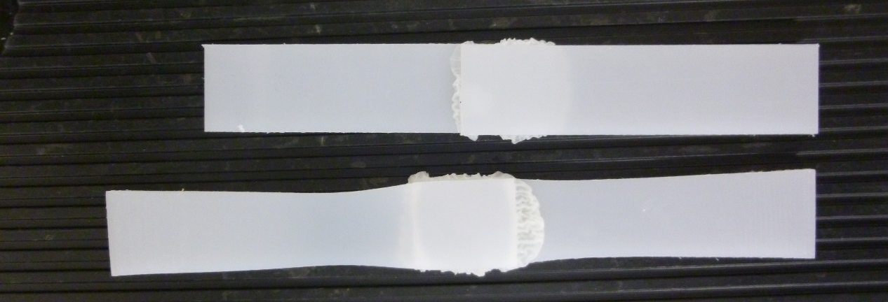
Structural Acrylics For Difficult to Bond Plastics
Polyolefins
Permabond TA4605 and TA4610 bond untreated polyolefin surfaces. They are ideal for bonding polypropylene, polyethylene, and PTFE without the need for pre-treatment. These Adhesives have much lower odor than MMAs.
Above polypropylene lap shears bonded with
TA4610 stretch and deform before the bond fails.

Slide 21
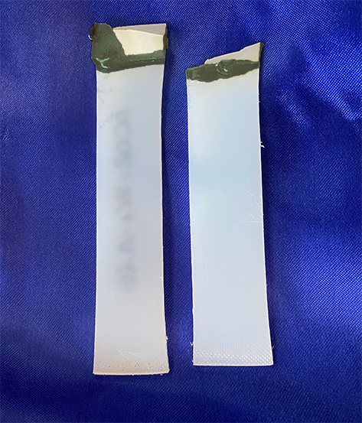

Structural Acrylics For Difficult to Bond Plastics
Nylon
NEW! Permabond TA4660 is a two-part structural adhesive ideal for bonding filled and unfilled nylon. No primer or surface pretreatment is needed to form bonds that exceed the strength of the nylon. This 2:1 mix ratio, low odor, room temperature curing adhesive also bonds metals.
Above nylon lap shears bonded with TA4660
deform and break before the bond fails.

Slide 22
Flexible Adhesives
Description
Modified Epoxies, and MS Polymers offer flexibility and provide
unique benefits. Their flexibility combined with low shrinkage make them ideal for bonding thin substrates with no read through and for potting without exerting stress on sensitive components.
Modified Epoxies are two component and MS Polymers are single component room temperature moisture curing.

Slide 23
Flexible Adhesives
Advantages
Absorb stresses from thermal expansion
Paintable
Non-corrosive
Fast Tack Free Time
Adhesion to a Variety of Substrates
No primer needed
Weather Resistant - No Cracking or Splitting
Ease of Application - Use in Most Weather Conditions

Slide 24
Polyurethane Adhesives
Description
Two component resin and hardener.
Used for bonding potting and encapsulating.

Slide 25
UV Curable Adhesives
Description
Single-part adhesives that rapidly polymerize while exposed to UV light.
Permabond has adhesives that cure with UV and Visible light.
A dual cure adhesive/sealant that cures anaerobically as well as with UV light is available for specialty applications.
Dual cure with moisture is also available.

Slide 26
UV Curable Adhesives
Factors Affecting Cure
Product
Light Intensity
-Distance
- Lamp focal point
- Transmission of light through the substrate.
- Measure intensity at the bond site.
Wavelength
- UV
- Visible
Time

Slide 27
Top Markets
Industrial Product OEM’s
Heat Exchangers
Filter Makers
Motor Magnet Bonding
Speaker Makers
Thread Locking
Gasket Makers
Aerospace
Applications to the Lockheed or Boeing specification
Electronics
Potting
High temperature bonding
Carbon Fiber bonding
Difficult / Dissimilar Substrates
LSE bonding TA46xx
Metals to Plastics

Slide 28
Questions…

